Slide 1
chain
Block

Slide 2

What does Blockchain have?
Several features that other databases haven’t got

Slide 3
Each immutable entry is written once, thereby increasing visibility and auditability, while reducing error rates
Authenticated counterparties digitally sign requests, updates and claims
Secure
Shared
Distributed
Authoritative
Each member of the network can use the Blockchain to validate the other counterparties
Applicants and beneficiaries collaborate in near real-time using standardized templates

Slide 4

Blockchain is a shared secured and distributed registry
Confirmed by encryption
Is based on reliable technology of signatures with public and private keys.
It allows you to create transactions in Blockchain that are protected what helps to establish a common trust

Slide 5

Blockchain is a shared secured and distributed registry
General access
The value of Blockchain technology is directly proportional to the number of organizations and companies using it.
Even in conditions of severe competition it is profitable for competitors to participate together in the deployment of this shared distributed database

Slide 6
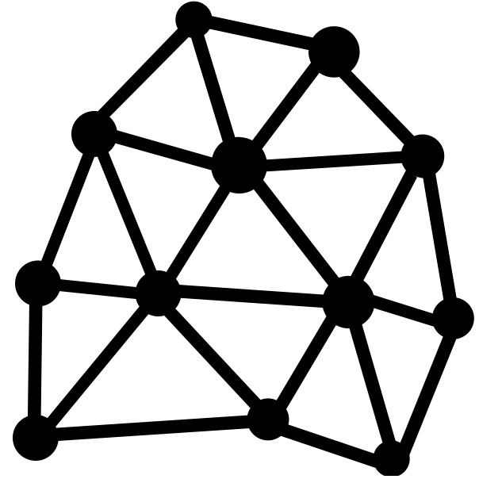
Blockchain is a shared secured and distributed registry
Distributed architecture
There are many lines of the Blockchain database. In fact, the are more lines, the higher the reliability of the data is

Slide 7

Blockchain is a shared secured and distributed registry
The Registry
The database has read and write access => it permanently records all transactions

Slide 8
DApp
Ethereum
We will talk about:
Bitcoin
Encryption
Decentralization

Slide 9
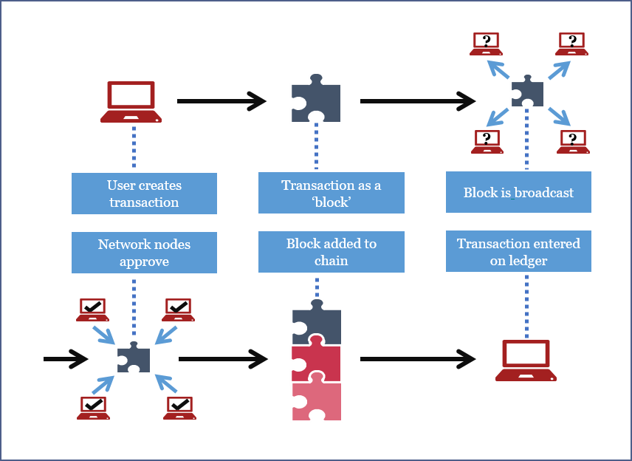
Transaction
Block
Network
Node
Chain of blocks
Ledger
europeanpaymentscouncil.eu

Slide 10
FIELD | Description | SIZE
Version nomber | Is 1 now | 4 bytes
In-counter | Positive integer VI = VarInt | 1 – 9 bytes
List of inputs | The first input of the first transaction is also called "coinbase" (its content was ignored in earlier versions) | Depends on inputs
Out-counter | Positive integer VI = VarInt | 1 – 9 bytes
List of outputs | The outputs of the first transaction spend the mined bitcoins for the block | Depends on outputs
Lock time | if non-zero and sequence numbers are<0xFFFFFFFF: block height or timestamp when transaction is final | 4 bytes
Transaction
Block
Network
Node
Chain of blocks
Ledger

Slide 11
FIELD | Description | SIZE
Magic nomber | value always 0xD9B4BEF9 | 4 bytes
Blocksize | Number of bytes following up to end of block | 4 bytes
Blockheader | 6 items : Version, hashPrevBlock, hashMerkleRoot, Time, Bits, Nonce | 80 bytes
Transaction counter | Positive integer VI = VarInt | 1 – 9 bytes
Transactions | List of transactions (non empty) | A lot of bytes
Transaction
Block
Network
Node
Chain of blocks
Ledger

Slide 12
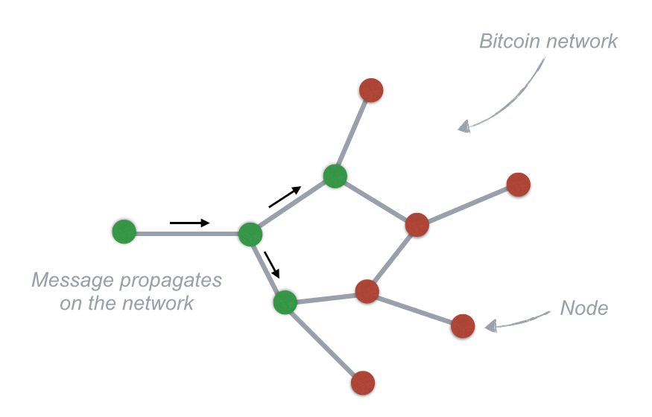
Transaction
Block
Network
Node
Chain of blocks
Any computer that connects to the Bitcoin network is called a node.
Ledger

Slide 13
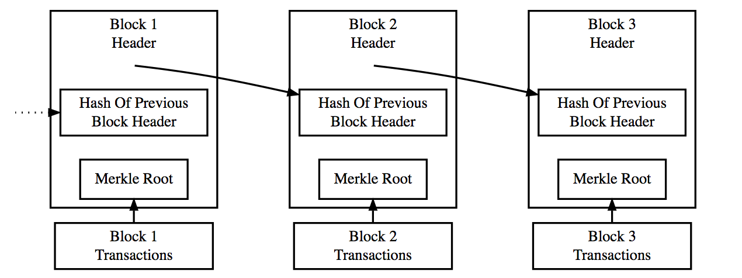
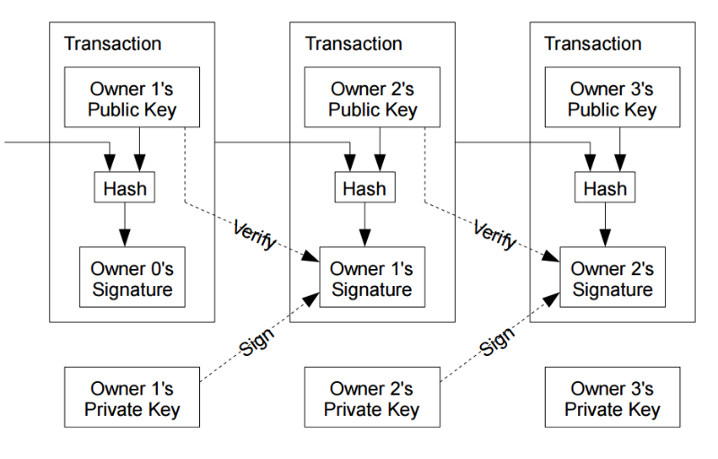
Transaction
Block
Network
Node
Chain of blocks
Ledger
steemit.com

Slide 14
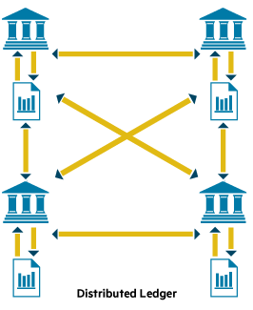
Transaction
Block
Network
Node
Chain of blocks
Ledger

Slide 15
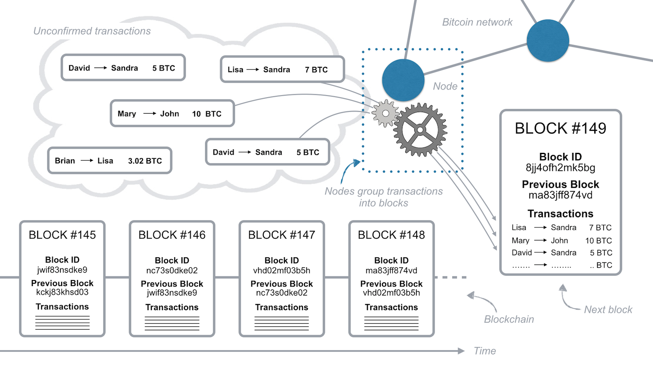
medium.com

Slide 16
Decentralization

Slide 17


Decentralization
Centralized system
Decentralized system

Slide 18
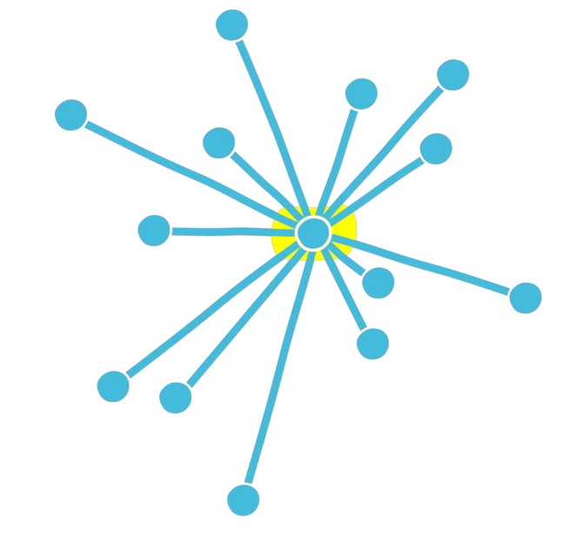
Decentralization
Centralized system
One control point
One point of failure
One point of trust
One point of attack
Single bottleneck system

Slide 19
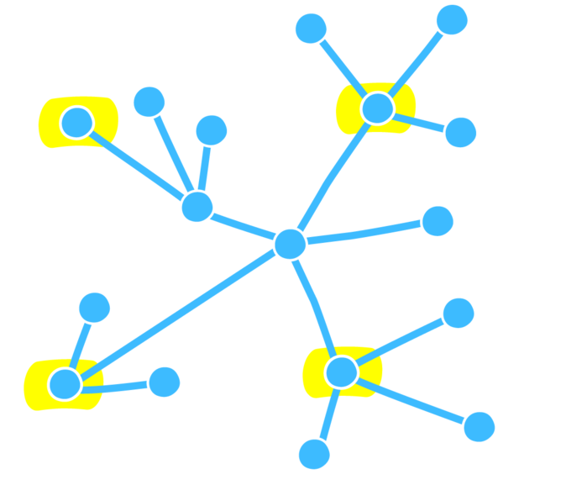
Decentralization
Decentralized system
We don‘t have control center
Based on agreement of participants

Slide 20
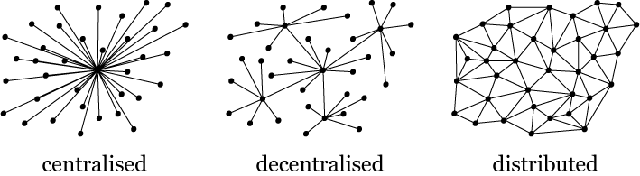
Decentralization
Blockchain Ledger

Slide 21
Decentralization is good

Slide 22
Decentralization is good
However…

Slide 23
If we don‘t have Central Authorities
We need to create a trust protocol
Without trusted 3rd parties

Slide 24
Who will keep the transaction log?
Who decides which transactions are valid?
How to reach agreement in decentralized network?

Slide 25

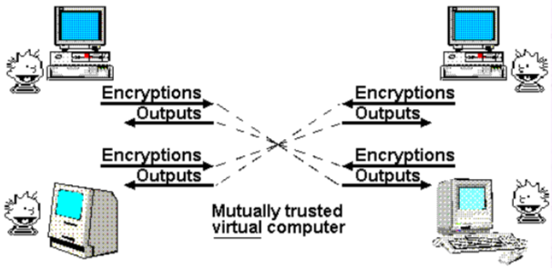
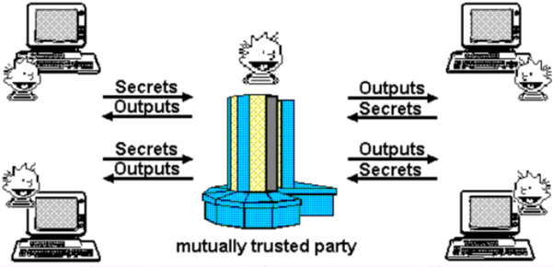
Nick Szabo — “The God Protocol”

Slide 26
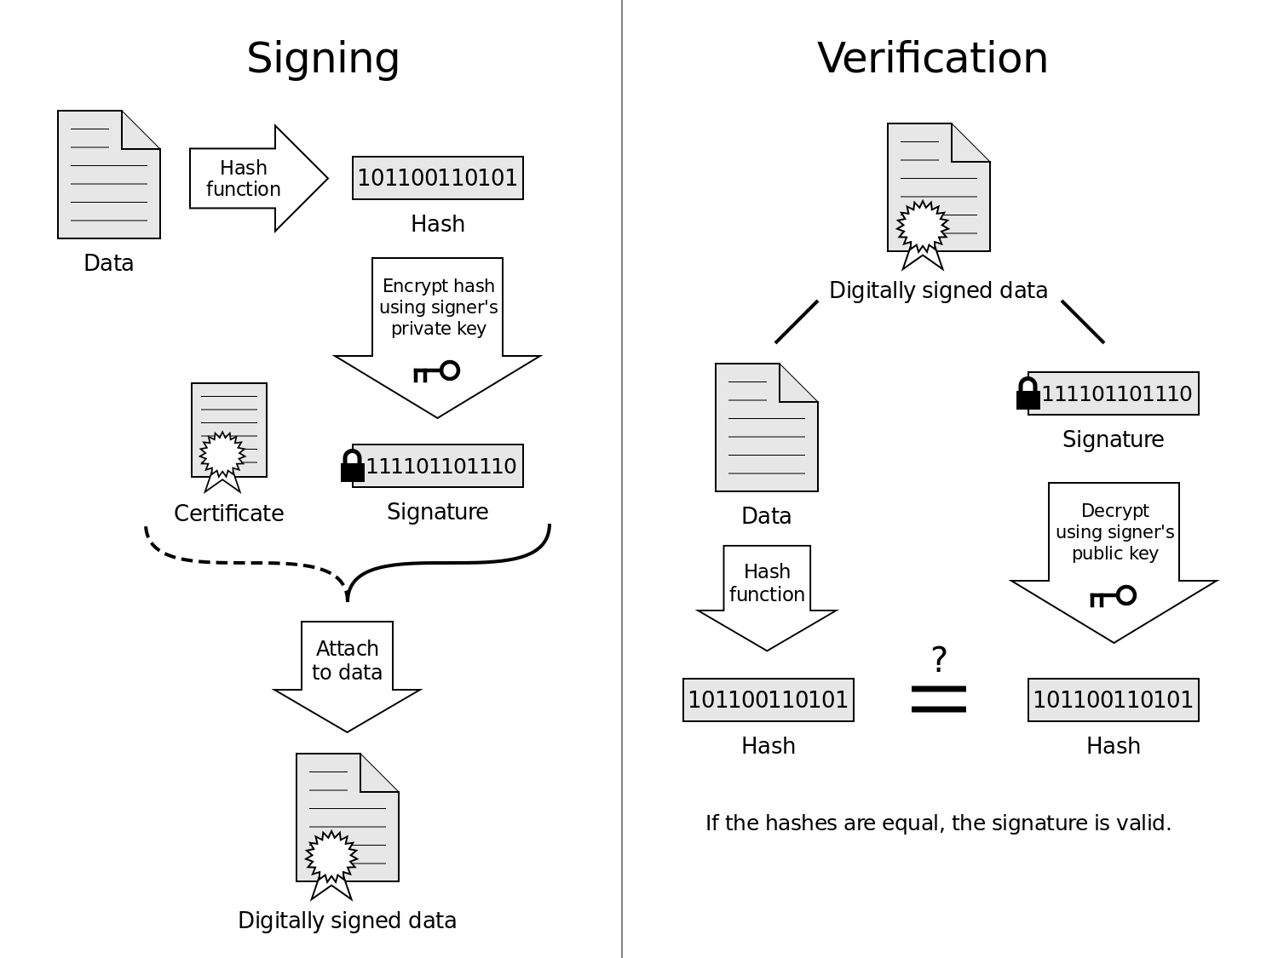
Solution : we replace trust by encryption
We need a payment system which will be based on encryption instead of trust
It allows anybody to make transaction without 3rd parties.

Slide 27
Questions

Slide 28
Encryption

Slide 29
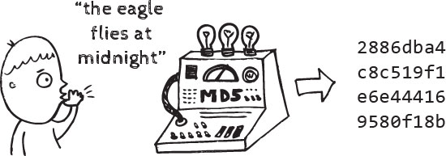
Encryption
Hash functions

Slide 30
Encryption
Hash functions
Deterministic transformation of any size data (input data) into fixed-size data (hash sums)
Hash h it should be hard to find any message m such that h=hash(m)
Input m1, it should be hard to find another input, m2 != m1 such that hash(m1)=hash(m2)
No information about input data

Slide 31
Encryption
*SHA256
Hash functions
Hello
185f8db32271fe25f561a6fc938b2e264306ec304eda518007d1764826381969
hello
2cf24dba5fb0a30e26e83b2ac5b9e29e1b161e5c1fa7425e73043362938b9824
2cf24dba5fb0a30e26e83b2ac5b9e29e1b161e5c1fa7425e73043362938b9824
d7914fe546b684688bb95f4f888a92dfc680603a75f23eb823658031fff766d9
Hello HSE students
ea526da0ea9e2f472afbdb647ffad0cd63567f59fb9a4bfa12429f5dbfed5c1e

Slide 32
Encryption
*SHA256
Info (i)
Hash function (H)
Hash code (i_{hash})
H(i) = i_{hash}

Slide 33
Encryption
*SHA256
Why Hash functions?
It helps to validate data
Identification case

Slide 34

Public-key encryption
Case: we need to safely send data to agent 2 when we have agent 3?
Agent 3
Agent 1
Agent 2
Information
Information

Slide 35
Public-key encryption
We will use keypairs
Private key
and
Public key
No data about Private key

Slide 36
Public-key encryption
Man in the middle problem
Agent 3
Agent 1 PBk
Agent 2 PBk
Agent 1
Agent 2
Information
Information
Agent 1 PVk
Agent 2 PVk

Slide 37
Public-key encryption
Information
encryption
d7914fe546b684688bb95f4f888a92dfc680603a75f23eb823658031fff766d9
Agent1 Side:
Agent 1 PBk

Slide 38
Public-key encryption
Solved!
Agent 3
?????????????
?????????????
Agent 1 PBk
Agent 2 PBk
Agent 1
Agent 2
d7914fe546b684688bb95f4f888a92dfc680603a75f23eb823658031fff766d9
d7914fe546b684688bb95f4f888a92dfc680603a75f23eb823658031fff766d9
Agent 1 PVk
Agent 2 PVk

Slide 39
Public-key encryption
d7914fe546b684688bb95f4f888a92dfc680603a75f23eb823658031fff766d9
Decryption
Agent2 Side:
Information
Agent 2 PVk

Slide 40
Generally
Information
Encryption
d7914fe546b684688bb95f4f888a92dfc680603a75f23eb823658031fff766d9
Public key
d7914fe546b684688bb95f4f888a92dfc680603a75f23eb823658031fff766d9
Decryption
Information
Private key

Slide 41
Public-key encryption with digital signature
Case: we need to safely send data to agent 2 when we have agent 3?
AND be sure that it‘s correct
Agent 3
Agent 1 PBk
Agent 2 PBk
Agent 1
Agent 2
d7914fe546b684688bb95f4f888a92dfc680603a75f23eb823658031fff766d9
ea526da0ea9e2f472afbdb647ffad0cd63567f59fb9a4bfa12429f5dbfed5c1e
*Add something*
Agent 1 PVk
Agent 2 PVk

Slide 42
Public-key encryption with digital signature
Digital signature
HASH + Public-key
Validate that information didn’t change after transaction
Validate that information is send by the correct agent

Slide 43
Public-key encryption with digital signature
Agent 1: making signature
Information
Encryption
Сipher
Public key
d7914fe546b684688bb95f4f888a92dfc680603a75f23eb823658031fff766d9
Hash
Encryption
Information
Signature
Private key

Slide 44
Public-key encryption with digital signature
Communication with digital signature
Agent 3
Agent 1 PBk
Agent 2 PBk
Agent 1
Agent 2
Сipher + Signature
Сipher + Signature
Agent 1 PVk
Agent 2 PVk

Slide 45
Public-key encryption with digital signature
Agent 2: checking process
Сipher
Decryption
Hash
d7914fe546b684688bb95f4f888a92dfc680603a75f23eb823658031fff766d9
Information
Private key
Signature
Decryption
d7914fe546b684688bb95f4f888a92dfc680603a75f23eb823658031fff766d9
The same or not?
Public key

Slide 46
Public-key encryption with digital signature
Attack scenarios:
1) Agent 3 will change information
2) Agent 3 will change information with his private key
1)
2)
Signature != Cipher
Decryption is impossible
(private key is not the same)

Slide 47
Questions

Slide 48
Bitcoin

Slide 49
Bitcoin
Let‘s make coin

Slide 50
Pay
Agent 1
Agent 2
We use MSUcoins

Slide 51
Agent 1 PVk
+
Pay
Agent 1 send Agent 2 1 MSUcoin
Agent 1
Agent 2
Digital signature with Private and Public keys
We can be sure that Agent1 really wants to send Agent2 a MSUcoin

Slide 52

Agent 1 PVk
+
Pay
Pay
Agent 1 send Agent 2 1 MSUcoin
Agent 1
Bank
Agent 2

Slide 53
Agent 1 PVk
+
Pay
Pay
Agent 1 send Agent 2 1 MSUcoin
Agent 1
Bank
Agent 2
Making everyone collectively the bank

Slide 54
Transactions log
+
Serial number
Transactions log
+
Pay
Agent 1 PVk
+
Agent 1 send Agent 2 1 MSUcoin
Agent 1
Agent 2
We’ll assume that everyone using MSUcoin keeps a complete record of which MSUcoin belong to which person. You can think of this as a shared public ledger showing all MSUcoin transactions. We’ll call this ledger the block chain, since that’s what the complete record will be called in Bitcoin, once we get to it.

Slide 55
Serial number
Agent 2
Transactions log
+
Pay
Agent 1 PVk
+
Pay
Agent 3
Transactions log
Agent 1 send Agent 2 1 MSUcoin
Agent 1
If Agent 1 will simultaneously send the same massage with the same serial number to Agent 2 and Agent 3, all of them confirm transaction Double cost problem

Slide 56
Serial number 1234567
Agent 2
Transactions log
+
Pay
Agent 1 PVk
+
Pay
Agent 3
Transactions log
Agent 1 send Agent 2 1 HSEcoin
Agent 1
All the world will be checking this transaction If it will be “ok” agent 2 and agent 3 will accept it
if Agent 1 tries to spend his HSEcoin with both Agent 2 and Agent 3, other people on the network will notice, and network users will tell both Agent 2 and Agent 3 that there is a problem with the transaction, and the transaction shouldn’t go through

Slide 57
Serial number 1234567
Agent 2
Transactions log
+
Pay
Agent 1 PVk
+
Pay
Agent 3
Transactions log
Agent 1 send Agent 2 1 HSEcoin
Agent 1
Both of them will have their own transaction log
But
Agents 1 transaction will be verified after 3-6 new block

Slide 58
Serial number 1234567
Agent 2
Transactions log
+
Pay
Agent 1 PVk
+
Pay
Agent 3
Transactions log
Agent 1 send Agent 2 1 HSEcoin
Agent 1
Verify
What if Agent 1 have a lot of friends who will help to make a double cost transaction?

Slide 59
Proof-of-work (PoW)
To make it computationally costly for network users to validate transactions
To reward them for trying to help validate transactions
Validation can no longer be influenced by the number of network identities someone controls, but only by the total computational power

Slide 60
Proof-of-work (PoW)
Send
PoW
Check
Agent 1
OK
OK
OK
Transactions log
Transactions log +1
Transactions log +2
Serial number 1234567
Serial number 4567
Serial number 56649

Slide 61
Proof-of-work (PoW)
Let H be a fixed hash function
Let Agents 1 transaction with label J
Suppose Agent 1 appends a number X (called the nonce) to J and hashes the combination

Slide 62
Proof-of-work (PoW)
“hello world!” = J and X = “0”
We have :
H("Hello, world!0")=1312af178c253f84028d480a6adc1e25e81caa44c749ec81976192e2ec934c64
Find X such that when we append X to J
We will have:
H("JX")= 0000c3af42fc31103f1fdc0151fa747ff87349a4714df7cc52ea464e12dcd4e9

Slide 63
Proof-of-work (PoW)
In the Bitcoin protocol, this validation process is called mining

Slide 64

HSEcoin
Decentralized registry with transaction log
Every person have the same registry
PoW verification

Slide 65
CAP theorem
CAP - Consistency, Availability, Partition tolerance. Can’t have all three!
If a network partition takes place you can’t have availability and consistency
FLP impossibility(Fisher, Lynch, Patterson)
Node deterministic algorithm can guarantee consensus in asynchronous setting
Dwork, Lynch, Stockmeyer 1984 Bounds on fault tolerance

Slide 66
Fork
Block 4 b
Block 5
Block 6
Block 1
Block 2
Block 3
Block 4 a

Slide 67
If Hash
Block 4 b
is longer than
Block 4 a
All miners will go to
Block 4 b

Slide 68
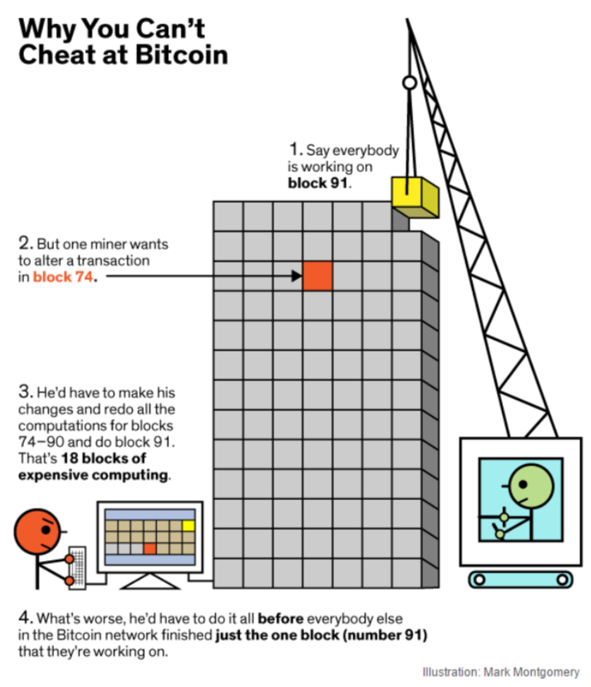
All the transactions will be verified only after 6 blocks

Slide 69
Questions

Slide 70
Ethereum

Slide 71

Public
Open-source
Features smart contract (scripting) functionality
Blockchain-based distributed computing platform

Slide 72
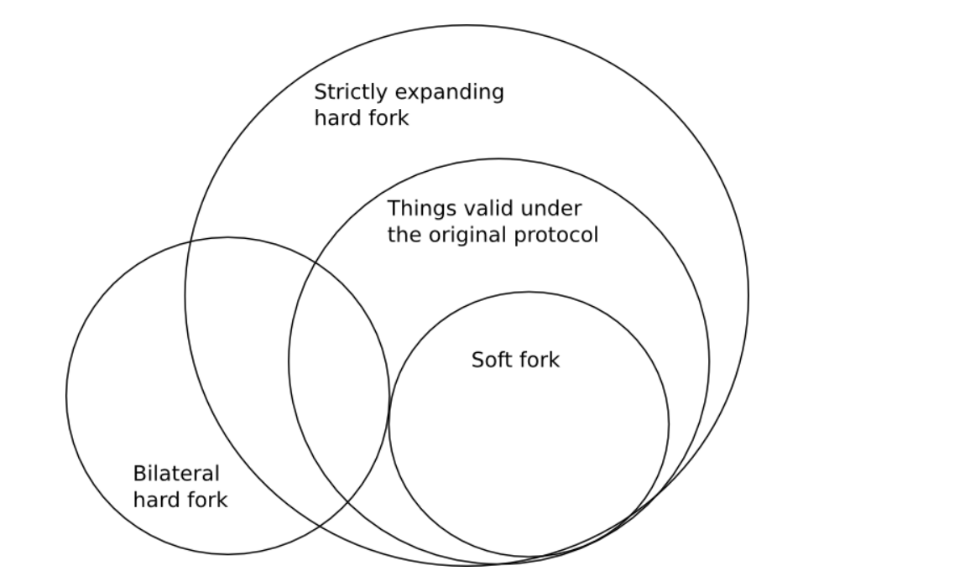
Can we change blockchain?

Slide 73
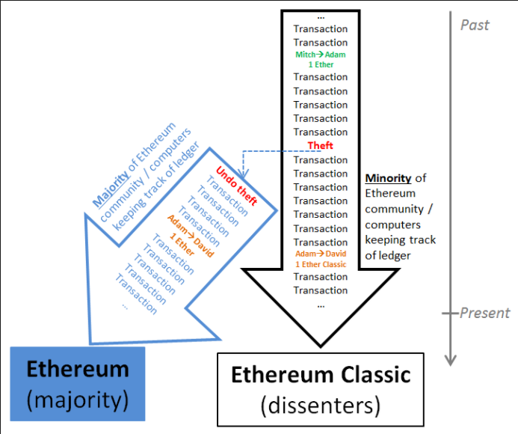
Can we change blockchain?
A soft fork where in it’s your choice whether you want to update or not.

Slide 74
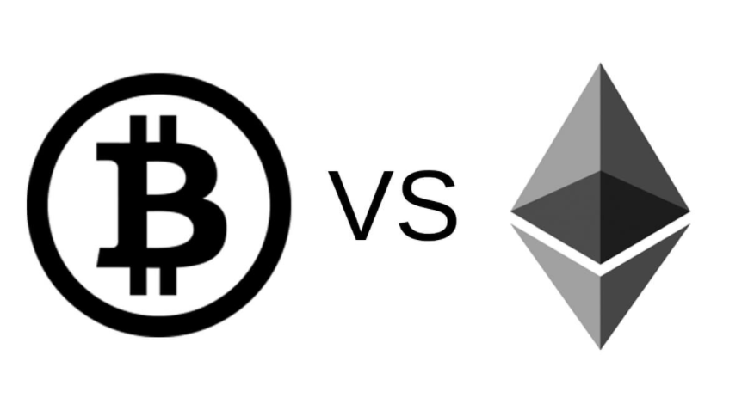
They are very different

Slide 75
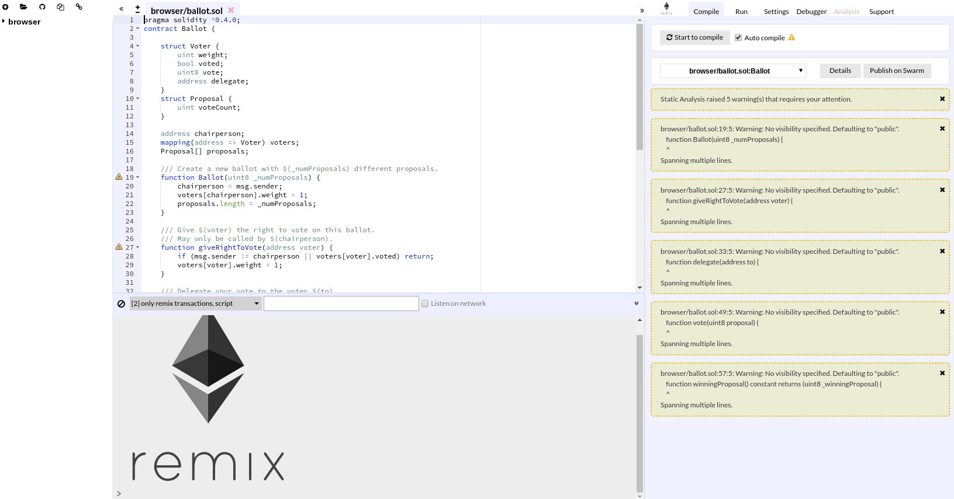
What do I need to use it?
Solidity
Remix
Internet
Desire
ICO

Slide 76
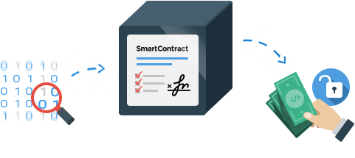
Smart contracts
Provide security that is superior to traditional contract law and to reduce other transaction costs associated with contracting
New ways to formalize the relationships
Contain code functions and can interact with other contracts, make decisions, store data, and send ether to others
Programming language = Solidity

Slide 77
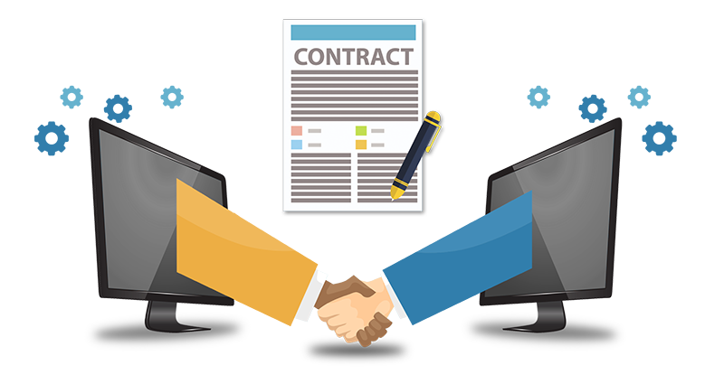
Smart contracts
contract Option {
trikePrice = $50
holder = Alice
seller = Bob
asset = 100 shares of Acme Inc.
expiryDate = June 1st, 2016
function exercise ( ) {
If Message Sender = holder, and
If Current Date<expiryDate, then
holder send($5,000) to seller, and
seller send(asset) to holder
}}

Slide 78
Practice?
remix.ethereum.org

Slide 79
DApp

Slide 80
DApp
DApp is smart contracts evolution from automatization point of view
Dapp – is group of smart-contracts in the Backend with GUI in the Frontend
We can make their implementation by uploading code into transaction and pasting it into our network

Slide 81
DApp
OpenBazaar
LaZooz
Twister
Gems
Storj

Slide 82
Resources
Melanie Swan - “Blockchain”
http://www.michaelnielsen.org/ddi/how-the-bitcoin-protocol-actually-works
https://ethereum.org
https://github.com/EnoRage/ssc

Slide 83

You!
Thank
Nick Kozlov – MSP (Rus)
Nikita.Kozlov@studentpartner.com
Kirill Kuznetsov
krboktv@gmail.com
| Microsoft Student Partners

